Slide 1


Slide 2


Slide 3


Slide 4


Slide 5


Slide 6


Slide 7


Slide 8


Slide 9


Slide 10
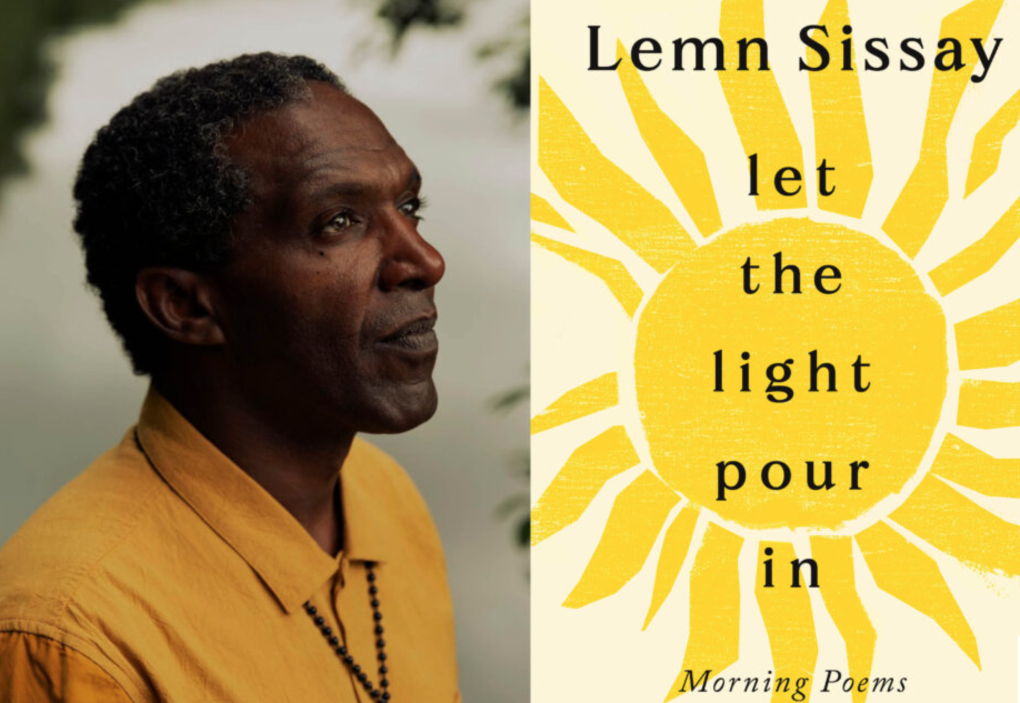

Slide 11
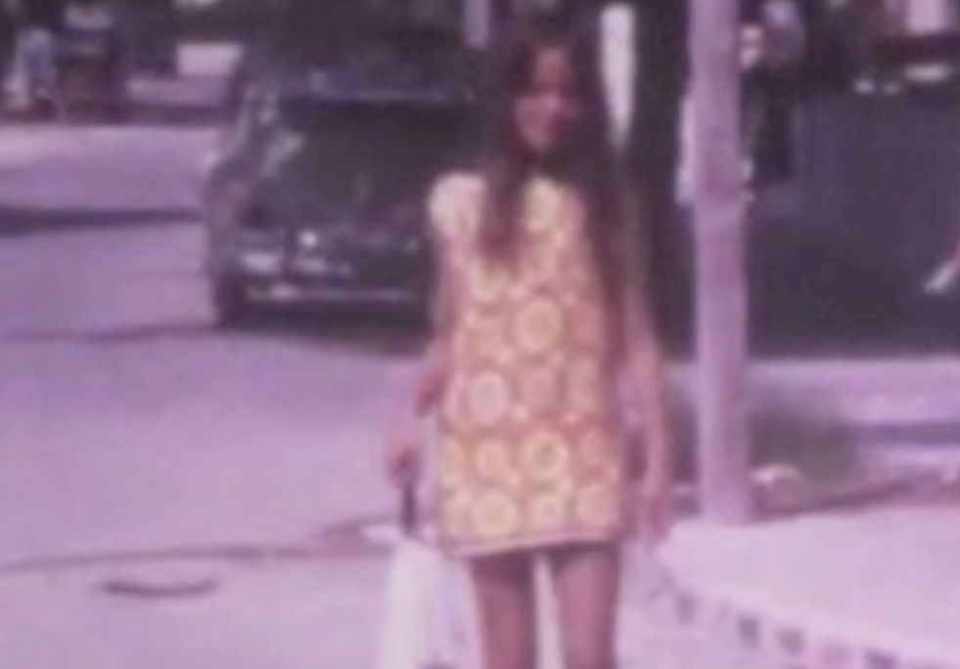

Slide 12
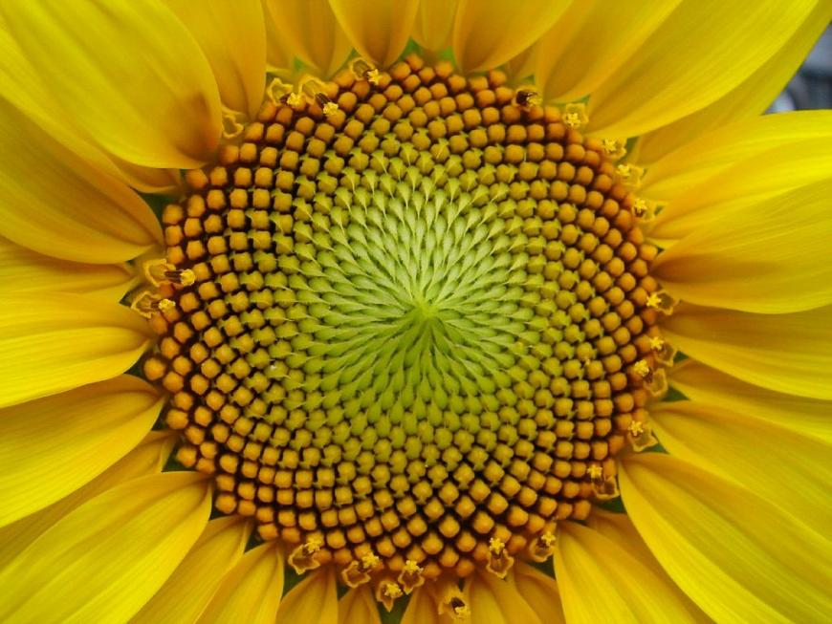
Notes:
He re-incarnated as the 16th century poetess MIRABAI

Slide 13
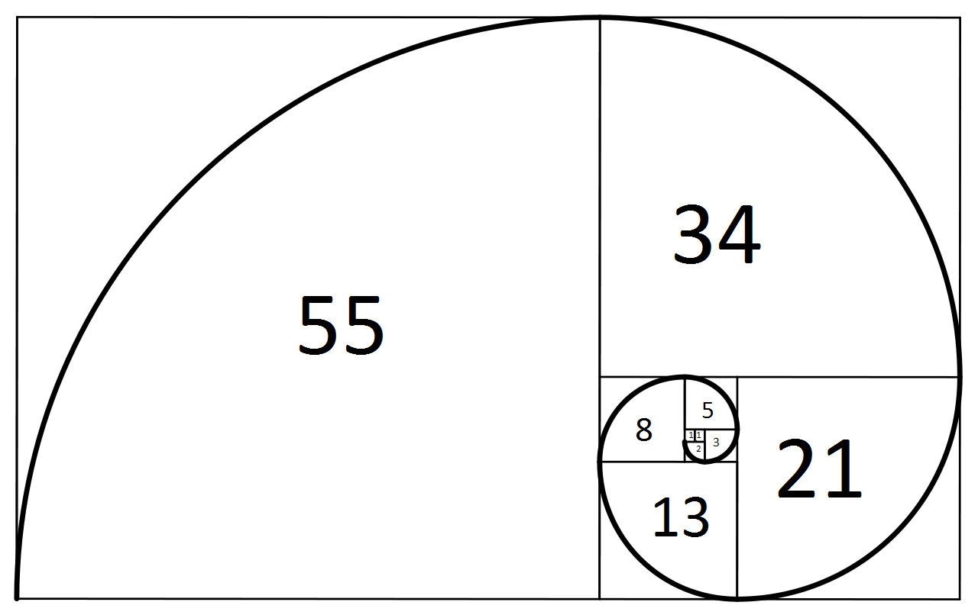
Notes:
Add them together and you get 108

Slide 14
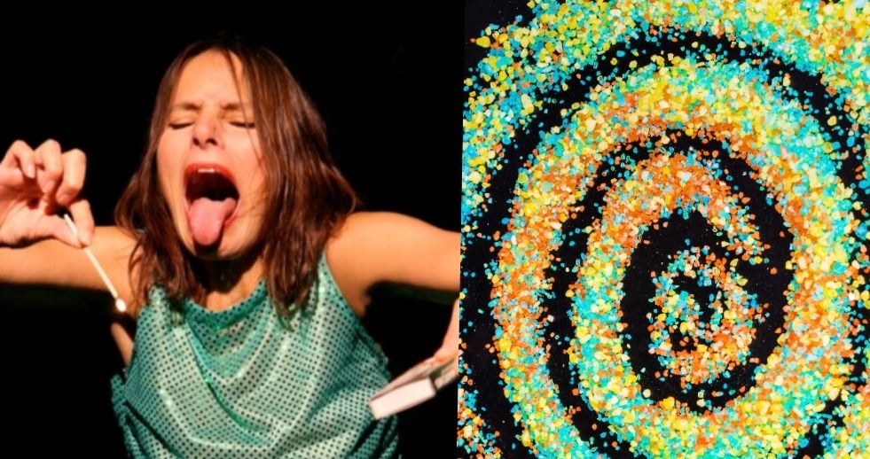

Slide 15


Slide 16
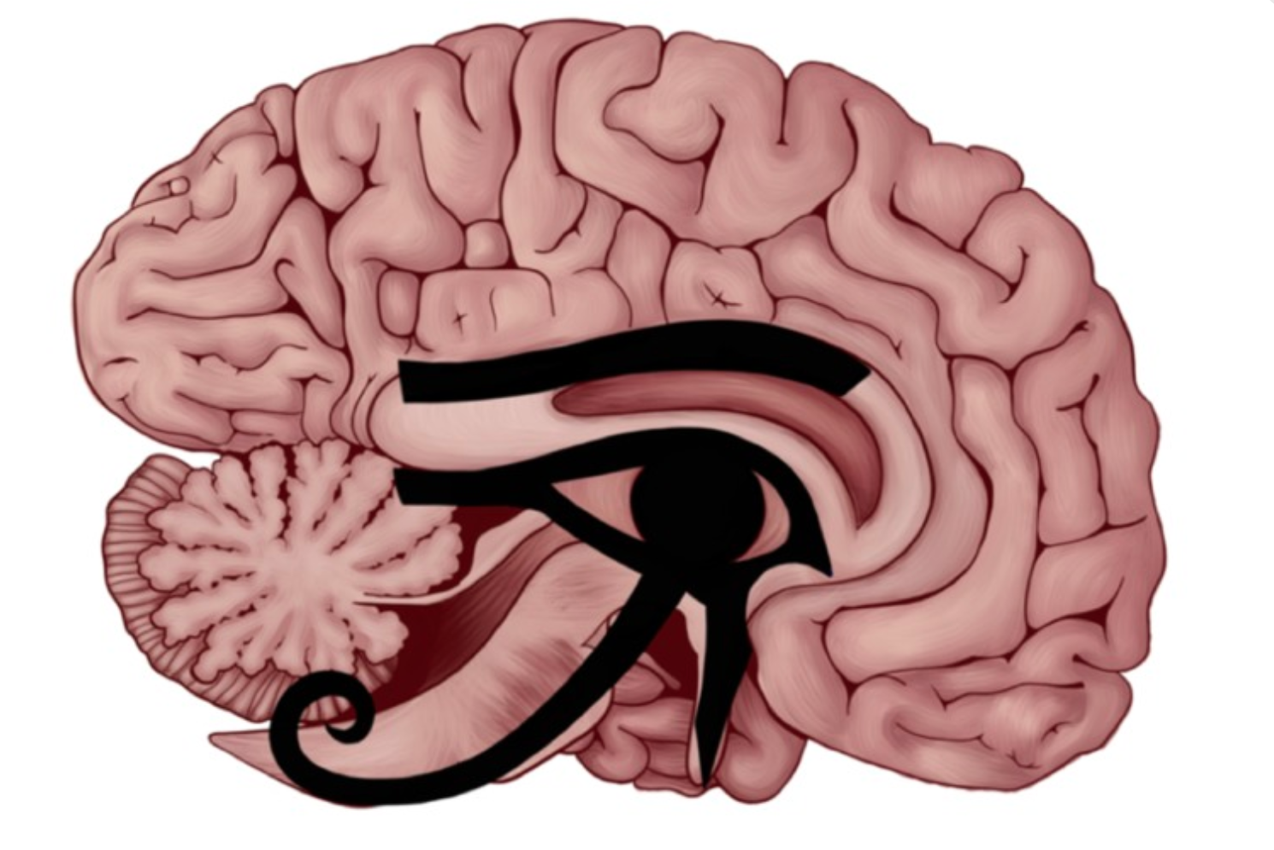

Slide 17
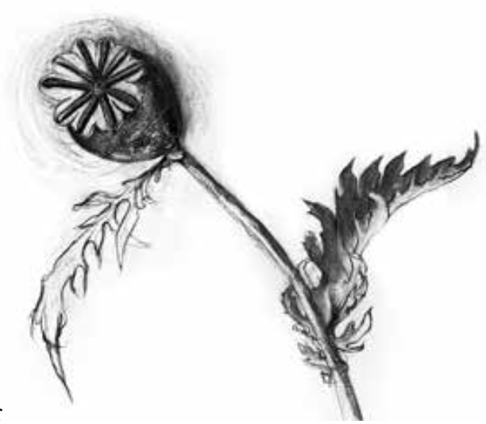


Slide 18
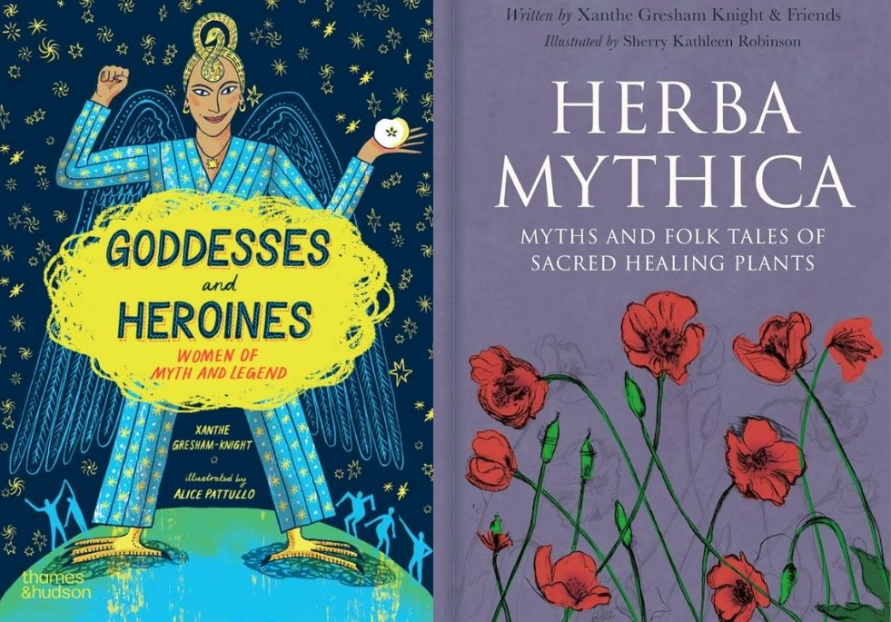

Slide 19
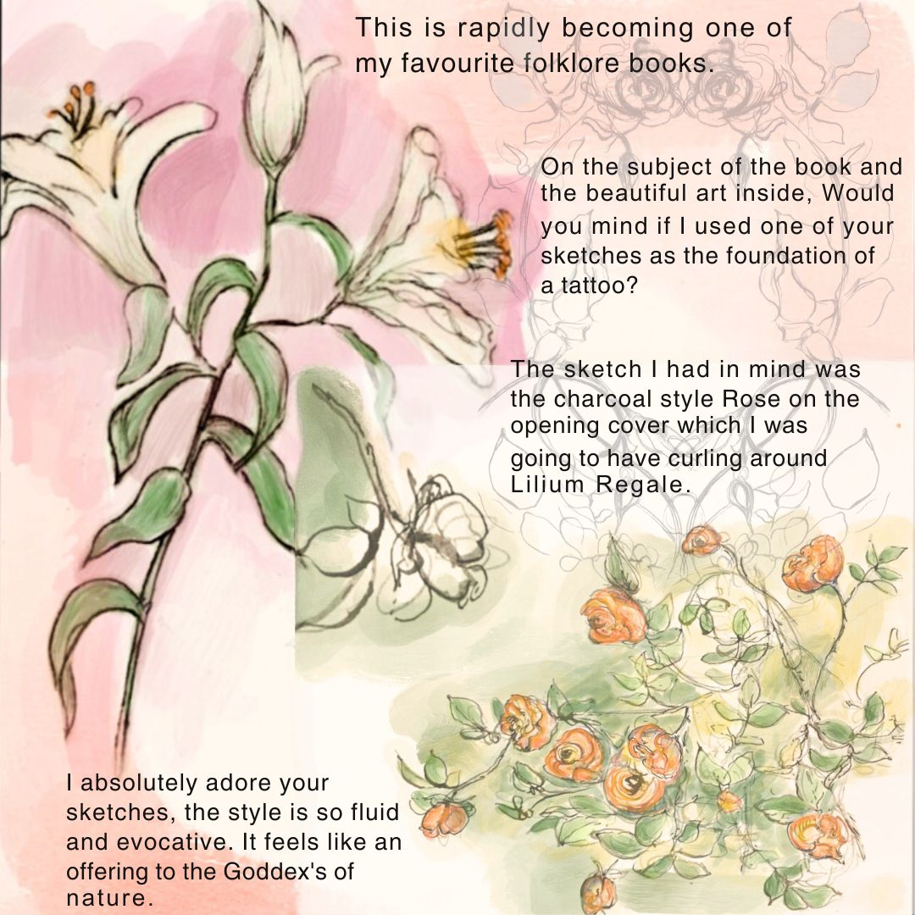

Slide 20


Slide 21


Slide 22


Slide 23


Slide 24


Slide 25


Slide 26


